Slide 1
Plan A: Stopping an Active Shooter Simulation of an Active Threat Scenario
Paige Li and Victor Chen
Mentored by Dr. Jory Denny
Notes:
Technical subtitle:

Slide 2
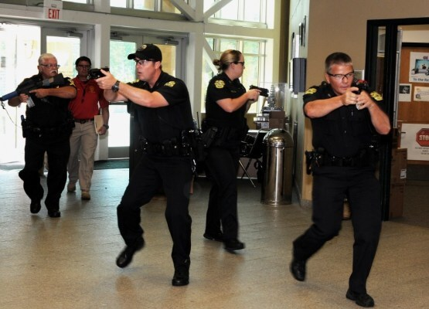
Research Goal and Motivation
Provide a preparational tool for law enforcement and campuses to help prepare for active threat crises
Develop an accurate and realistic model of active threat situations by combining a multi-agent system with a physically-based simulator
Photo: https://www.homelandsecuritykc.com/active-threats/

Slide 3

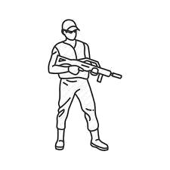
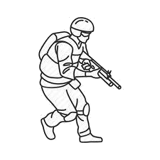



Contribution
We designed three realistic artificial intelligence behaviors for the actors in these situations
We composed an example demonstration of them interacting together
Threat Responder People
Notes:
space out agent pics

Slide 4
Agent Overview
Behaviors
Determines what goal the agent needs to reach
Motion Planners
Determines subgoals needed to avoid obstacles
Local Controller
Determines a force to accelerate the agent
Motion Model
Alters the agent’s position and velocity
Notes:
Turn into a flow from each diagram to the next. See pic

Slide 5
Multi-Behavior
We chose to represent our three complex behaviors (Threat, Responder, Person) as state transition diagrams.
Each state in this diagram is a smaller and simpler behavior
Transitions between states represent events in the scenario.
!
!
Loitering
Evasion
!
Notes:
Add state diagram below animation. Change shape outline color to white.

Slide 6
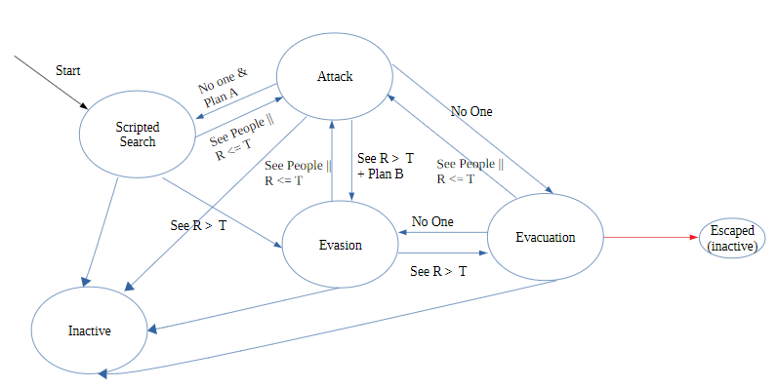
Threat
The threat agent transitions through the following behaviors:
Scripted Search
Evasion
Attack
Evacuation
Changes behavior based on the number of responders or people within its cone of vision
If the threat sees responders in the building, it will attempt to evade and evacuate out of the property.

Slide 7
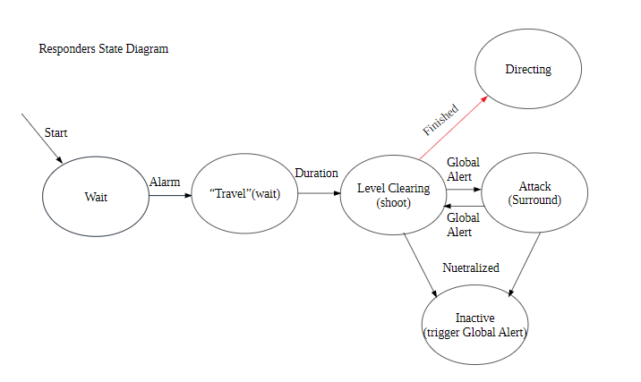
Responder
The responder agents transition through the following behaviors:
Level Clearing
Surround
The main goal of the responder group is to neutralize the threat, not to direct and protect the people within the building.

Slide 8
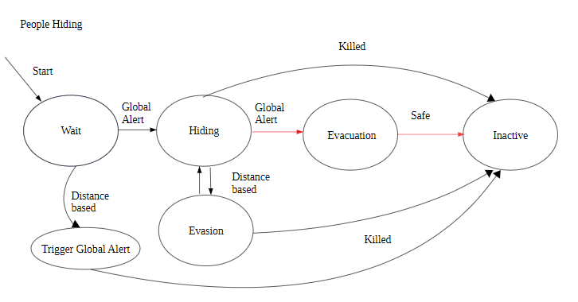
People
The people agent transitions through the following behaviors:
Waiting
Hiding
Evasion
Evacuation
People will attempt to hide within the building until an all clear is given by the responders after neutralizing the threat.

Slide 9
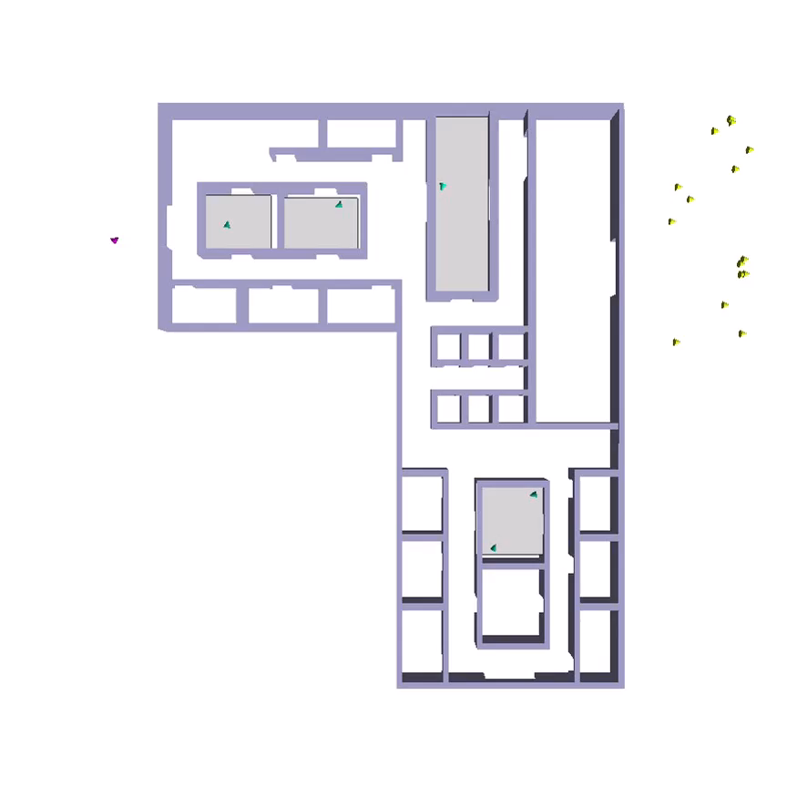
Active Threat Scenario
Threat
People
Neutralized Threat
Neutralized Agent
Responders
Threat and responders start outside the building.
People loiter around inside the structure.
Threat attacks people in view range. This sends
an alert to other people in the building to hide and
to the responders to enter the building.
After a responder is neutralized,
other responders will create a surrounding
formation around that agent’s position.
Notes:
Active threat scenario for title

Slide 10
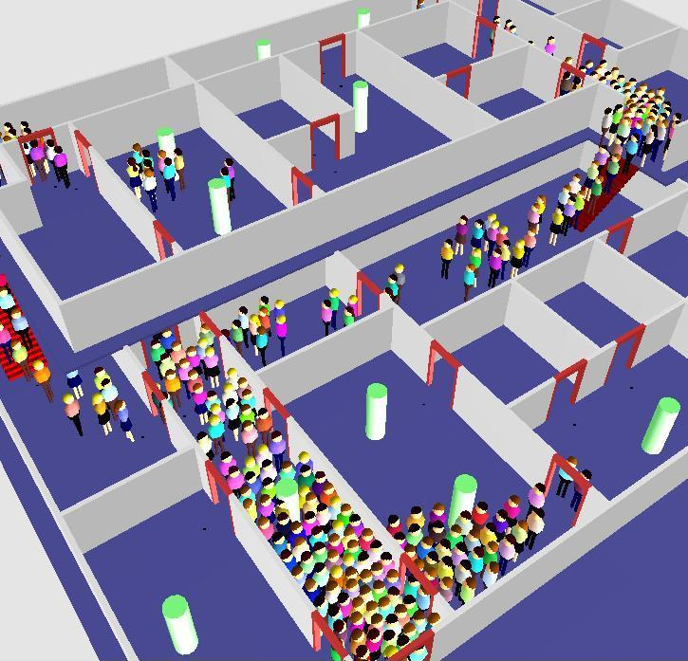
Future Work
Experimentally analyze our approach
Improve efficiency and complexity of current behaviors
Simulating these behaviors in multi-level buildings
Improving graphical display
http://herd.typepad.com/herd_the_hidden_truth_abo/2009/03/when-wouldbe-models-panic.html

